Slide 1

D. Y. PATIL COLLEGE OF ENGINEERING,
AKURDI, PUNE
Department of Electronics and Telecommunication
Mini project
on
Text To Speech Converter for Visually Impaired People
Presented by
Student name
Shubham Kharat
Mahima Singh
Harshvardhan Natu
Exam seat no.
72018203E

Slide 2
Content
Introduction
Challenges & motivation
Literature Survey
Block diagram
Circuit Diagram
Simulation
System Configuration
Results and Discussion
Conclusion
References

Slide 3
Introduction
Motivation
Text to speech converter can be used for many application, such as Audio books,Google assistant,etc. We use of text to speech converter very frequently and it has become very common to us . People with visual impairment face difficulties in their daily life to read or access printed text documents,even people with low vision also face similar difficulties while dealing with text documents.Here, text to speech converter will be of great help to such people,as it can read any text aloud whatever that has been written on screen .
Objective
Aim of our proposed project is to overcome the reading problems of Visually Impaired(VI) people.This project will assist the blind people to read text printed on pamphlets, newspapers and books.

Slide 4
Text to speech converter
The TTS system gets the text as the input ,
is synthesized the speech
The first phase is text analysis
the second phase is the generation of speech
waveforms

Slide 5
Block diagram
Arduino UNO
Audio Amplifier Circuits
Speaker

Slide 6
For working inside Arduino UNO
The TTS system gets the text as the input and then a computer algorithm which called TTS engine analyses the text, pre-processes the text and synthesizes the speech with some mathematical models.
Text to speech synthesizer
Natural language processing
Conversion into phonemes
Digital signal processing
Mathematical models,algorithms
phoneme
Text
Speech

Slide 7
Selection of Components:
1. Arduino Uno
2. Audio Amplifier LM386
3. Resistors (10kΩ, 100kΩ)
4. Capacitors (0.05uF , 0.1uF ,10uF , 220uF )
5. Speaker (8Ω, 5V)
6. 9V Battery

Slide 8
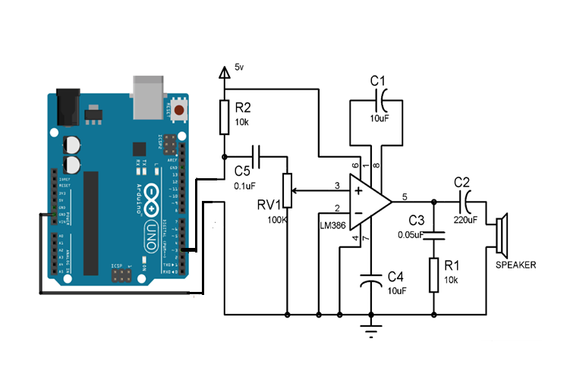
Circuit Diagram

Slide 9
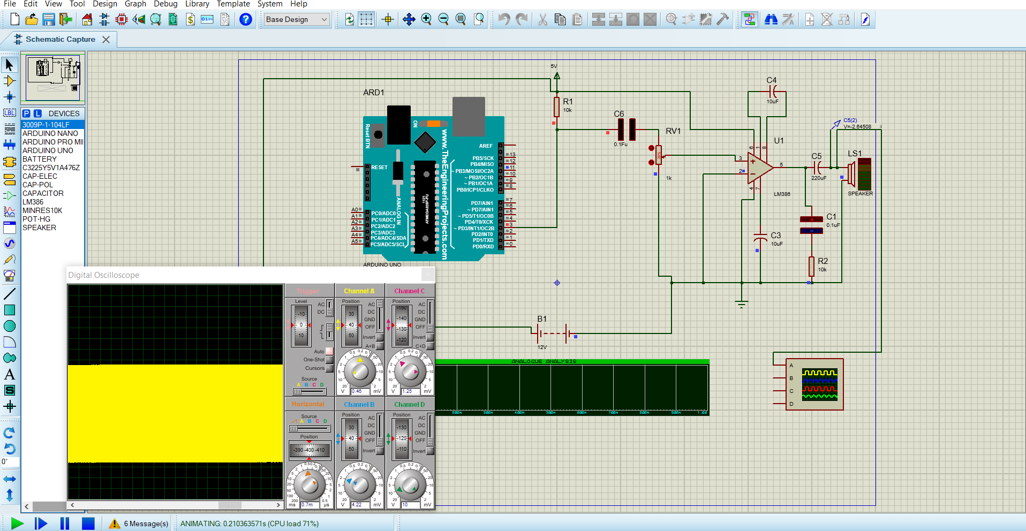
Simulation

Slide 10
Conclusion
Providing visually challenged people with better reading abilities has been a major challenge.
This TTS system aims at providing a better option for such people.Text given to the text to speech converter can be converted into speech with the help of Arduino and built in libraries .
This project ,once implemented with proper programming , libraries and different language support , will be of great help to visually impaired people.
Further development includes providing a sense of direction to the person reading something.

Slide 11
REFERENCES
[1].Swathi, G., Mai, c.k, and Babu, B.R., 2013.Speech Synthesis System for Telugu Language . International journal of computer application(0975 – 8887),Volume 81- No5.
[2]Mohanan, S., Salkar, S., Naik, G., Dessai, N.B., and Naik, S., 2012.Text To Speech Synthesizer for Konkani Language. International Conference on Computing and Control Engineering (ICCCE 2012),12 & 13 April,ISBN 978-1-4675-2248-9

Slide 12
Thank You.

